Slide 1
SQL

Slide 2
What is SQL?
SQL stands for Structured Query Language
SQL is a standard language for storing, manipulating and retrieving data in databases.
SQL lets you access and manipulate databases
SQL is an ANSI (American National Standards Institute) standard

Slide 3
SQL
SQL is used to make a request to retrieve data from a Database.
• The DBMS processes the SQL request, retrieves the requested data from the Database, and returns it.
• This process of requesting data from a Database and receiving back the results is called a Database Query and hence the name Structured Query Language.

Slide 4
SQL is a language that all commercial RDBMS implementations understand.
• SQL is a non-procedural language
• We would be discussing SQL with respect to oracle syntax

Slide 5
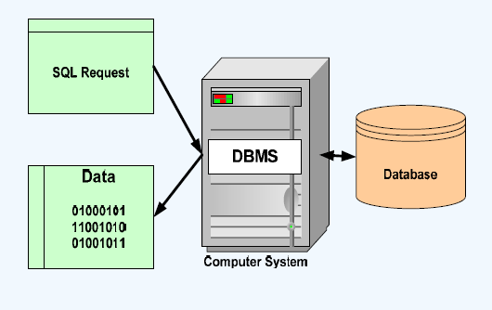
How SQL Works ?

Slide 6
What Can SQL do?
SQL can execute queries against a database
SQL can retrieve data from a database
SQL can insert records in a database
SQL can update records in a database
SQL can delete records from a database
SQL can create new databases
SQL can create new tables in a database
SQL can create stored procedures in a database
SQL can create views in a database
SQL can set permissions on tables, procedures, and views

Slide 7
SQL Statements
DDL (Data Definition Language)
Create - Creates a new table, a view of a table, or other object in the database.
Alter - Modifies an existing database object, such as a table.
Drop - Deletes an entire table, a view of a table or other objects in the database.
Truncate - Is used to delete complete data from an existing table.

Slide 8
SQL Statements
DML (Data Manipulation Language)
Insert - Creates a record.
Update - Modifies records.
Delete - Deletes records.
Select - Retrieves certain records from one or more tables.

Slide 9
SQL Statements
DCL (Data Control Language)
Grant - Gives a privilege to user.
Revoke - Takes back privileges granted from user.

Slide 10
SQL Statements
TCL (Transaction Control Language)
Commit - To save the changes.
Rollback - To roll back the changes.

Slide 11
Data types
Data Type | Explanation
Char (size) | Where size is the number of characters to store. Fixed length strings. Space padded. The maximum number of characters this data type can hold is 255 characters.
Varchar(size)/varchar2(size) | Where size is the number of characters to store. variable length strings.
Date | Standard format is DD – MON – YY
Number(p , s) | Where p is the precision and s is the scale. For ex. Number(7,2) is a number that has 5 digits before the decimal and 2 digits after the decimal.

Slide 12
Data types
Data Type | Explanation
Long | Variable-length character data up to 2 gigabytes
CLOB | Character data up to 4 gigabytes
RAW and LONG RAW | Raw binary data
BLOB | Binary data up to 4 gigabytes
BFILE | Binary data stored in an external file; up to 4 gigabytes

Slide 13
DDL(Data Definition Language)

Slide 14
Creating and Managing Tables

Slide 15
Objectives
After completing this lesson, you should be able to do the following
Describe the main database objects
Create tables
Describe the data types that can be used when specifying column definition
Alter table definitions
Drop, rename, and truncate tables

Slide 16
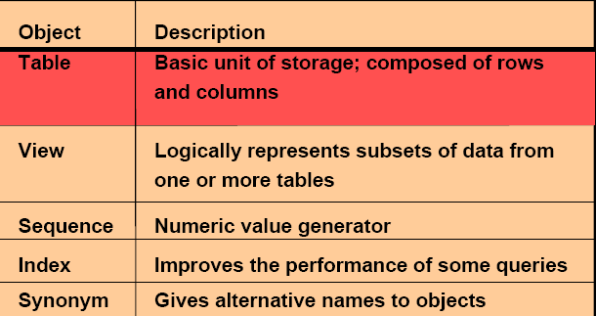
Database Objects

Slide 17
What is a table?
The data in an RDBMS is stored in database objects which are called as tables. This table is basically a collection of related data entries and it consists of numerous columns and rows.
Remember, a table is the most common and simplest form of data storage in a relational database. The following program is an example of a CUSTOMERS table −

Slide 18
Table Example
ID | NAME | AGE | ADDRESS | SALARY
1 | Ramesh | 23 | Ghaziabad | 22,000
2 | Deeptih | 21 | Kanpur | 20.000
3 | Komal | 35 | Meerut | 35,000
4 | Sekhar | 25 | Delhi | 21,000
5 | Saurabh | 28 | Calcutta | 32,000
6 | Mufti | 37 | Agra | 35,000
7 | Ashutosh | 32 | Mumbai | 22,000

Slide 19
What is a field?
Every table is broken up into smaller entities called fields. The fields in the CUSTOMERS table consist of ID, NAME, AGE, ADDRESS and SALARY.
A field is a column in a table that is designed to maintain specific information about every record in the table.

Slide 20
What is a Record or a Row?
A record is also called as a row of data is each individual entry that exists in a table. For example, there are 7 records in the above CUSTOMERS table.
1 | Ramesh | 23 | Ghaziabad | 22,000

Slide 21
What is a column?
A column is a vertical entity in a table that contains all information associated with a specific field in a table.
For example, a column in the CUSTOMERS table is ADDRESS, which represents location description and would be as shown below.
NAME
Ramesh
Deeptih
Komal
Sekhar
Saurabh
Mufti
Ashutosh

Slide 22
Naming Rules
Table names and column names:
Must begin with a letter
Must be 1–30 characters long
Must contain only A–Z, a–z, 0–9, _, $, and #
Must not duplicate the name of another object owned by the same user
Must not be an Oracle server reserved word

Slide 23
The CREATE TABLE Command
Syntax – CREATE TABLE Tablename
(
ColumnName1 Datatype(Size),
ColumnName2 Datatype(Size),
…………………………………………..
…………………………………….
);

Slide 24
Example create table
Ex. – CREATE TABLE Student
( Roll number(5),
Name varchar2(30)
);

Slide 25
Example create table
Ex. – CREATE TABLE Employee
( ID number(5),
Name varchar2(30),
Age number(3),
Address varchar2(30),
Salary number(7)
);

Slide 26
To see the structure of the Table
DESCRIBE Tablename;
DESCRIBE student;

Slide 27
The ALTER TABLE Statement
Use the ALTER TABLE statement to:
Add a new column
Modify an existing column
Define a default value for the new column
Drop a column

Slide 28
The ALTER TABLE Statement
Adding New Columns –
Syntax – ALTER TABLE Tablename
ADD ( NewColumnName Datatype(size),
NewColumnName Datatype(size));
Ex- Add a field named branch to the newly created table student.
ALTER TABLE student
ADD (branch varchar2 (10));

Slide 29
The ALTER TABLE Statement
Droping a Column from a table –
Syntax – ALTER TABLE Tablename
DROP COLUMN columnname;
Ex- Drop branch field from student table
ALTER TABLE student
DROP COLUMN branch;

Slide 30
The ALTER TABLE Statement
Modifying Existing Columns
Syntax – ALTER TABLE Tablename
MODIFY ( ColumnName NewDatatype(Newsize),
Ex- Modify name field of student table to varchar2(35).
ALTER TABLE student
modify name varchar2(35);
Restrictions – we cannot do the following with the ALTER TABLE COMMAND.
Decrease the size of a column if table data exists.

Slide 31
Renaming Tables
RENAME Command
Syntax – ALTER TABLE Tablename
RENAME TO NewTableName
Ex- ALTER TABLE student
RENAME TO student1;

Slide 32
Renaming Columns
RENAME COLUMN statement
Syntax-
ALTER TABLE Tablename
RENAME COLUMN oldColumnName TO NewColumnName
Ex - ALTER TABLE Employee
RENAME COLUMN MANAGER TO SUPERVISOR

Slide 33
Dropping a Table
All data and structure in the table is deleted.
Any pending transactions are committed.
All indexes are dropped.
You cannot rollback the DROP TABLE statement.
Syntax – DROP TABLE TableName;
Ex – DROP TABLE student;

Slide 34
Truncating a Table
The TRUNCATE TABLE statement:
Removes all rows from a table
Releases the storage space used by that table
You cannot roll back row removal when using TRUNCATE.
Syntax - TRUNCATE TABLE TableName;
Ex - TRUNCATE TABLE student;

Slide 35
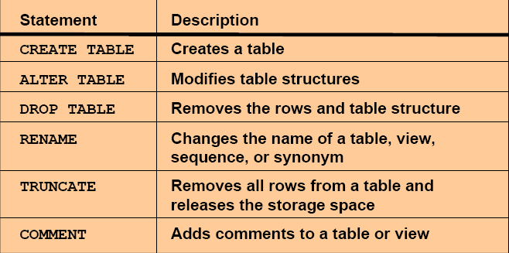
Summary
In this lesson, you should have learned how to use DDL statements to create, alter, drop, and rename tables.

Slide 36
Manipulating Data DML Statement

Slide 37
Objectives
After completing this lesson, you should be able to do the following:
Describe each DML statement
Insert rows into a table
Update rows in a table
Delete rows from a table
Merge rows in a table

Slide 38
A DML statement is executed when you:
Add new rows to a table
Modify existing rows in a table
Remove existing rows from a table
Retrieve records from a table

Slide 39
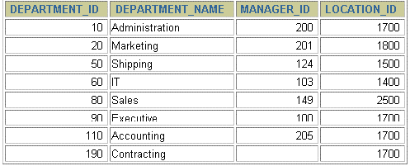
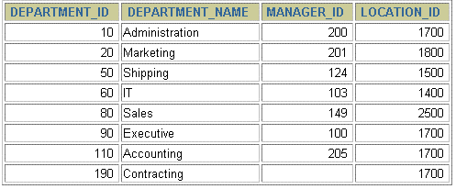
Adding a New Row to a Table
New
row
DEPARTMENTS
insert a new row
into the
DEPARMENTS
table…

Slide 40
Inserting Data Into Tables
Syntax – INSERT INTO tablename (columnname1, columnname2,……) values (data1,data2,……);
Ex – INSERT INTO student (roll,name) values(1,’yatin’) ;

Slide 41
Inserting Data Into Tables
Points to remember:
Table columns & values have a one to one relationship.
If there are exactly the same number of values as there are columns and the values are sequenced in exactly in accordance with the data type of the table columns , there is no need to indicate the column names.
If there are less values being described than there are columns in the table then it is mandatory to indicate both the table column name and its corresponding value.
Only one row is inserted at a time with this syntax.
Enclose character and date values within single quotation marks.

Slide 42
Interacting Data Insertion
Syntax – INSERT INTO tablename
(columnname1,columnname2,……)
values (&columnname1,&columnname2,……);
Ex - INSERT INTO student (roll, name) values(&roll, ’&name’);

Slide 43
Concept of NULL
NULL
Missing / unknown / inapplicable data represented as a null value
NULL is not a data value. It is just an indicator that the value is unknown

Slide 44
Inserting Rows with Null Values
Implicit method: Omit the column from the column list.
INSERT INTO departments
(department_id, department_name)
VALUES (30, 'Purchasing');
Explicit method: Specify the NULL keyword in the VALUES clause.
INSERT INTO departments
VALUES (100, 'Finance', NULL, NULL);

Slide 45
A table named Emp is given as follows
Emp
( EmpId number (5),
Name varchar2(30),
Dept varchar2(10),
Doj date,
Dob date,
salary number(7)
)
Insert the following record 1, Ram Kumar, MCA, 27/07/2009, 15/08/1982, 25000
Insert the following record 2, Aman Jain, MCA, 27/07/2008, 15/08/1985, 20000
Insert the following record 3, Anita Verma, MCA, 17/05/2008, 25/09/1985

Slide 46
Create table emp
( empid number(5),
name varchar2(30),
dept varchar(10),
doj date,
dob date,
salary number(7)
);
Insert into emp(empid, name, dept, doj, dob, salary) values(1, ‘ Ram Kumar’ , ‘MCA’, ‘ 27-July-09’, ’15-Aug-82’, 20000);

Slide 47
EmpId | Name | Dept | Doj | Dob | Salary
1 | Ram Kumar | MCA | 27/07/2009 | 15/08/1982 | 25000
2 | Aman Jain | MCA | 27/07/2008 | 15/8/1985 | 20000
3 | Anita Verma | MCA | 17/05/2008 | 25/09/1985 | -
4 | Anjali | CS | 12/06/2010 | 15/7/1985 | 20000
5 | Rohan | IT | 12/06/2010 | 27/09/1976 | 35000
6 | Jatin | CS | 10/06/2018 | 17/06/1978 | 40000
List out all the employee details
List the employees who are working in MCA department
List the empid, name and department of all the employees
List the empid, name and department of those employees who are getting salary of 20000.

Slide 48
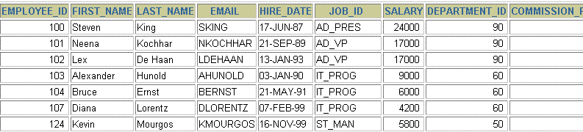
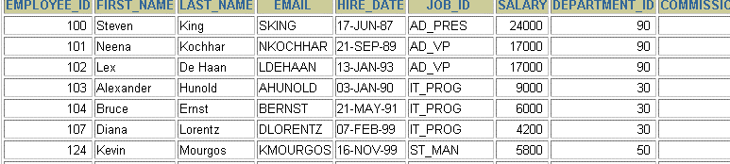
Changing Data in a Table
EMPLOYEES
Update rows in the EMPLOYEES table.

Slide 49
The UPDATE Statement Syntax
Syntax –
UPDATE Tablename
SET columnName1 = value ,
columnName2 = value, ...
WHERE condition;
Note -
Without where condition all the rows get updated.
Depending upon where condition selected rows get updated.

Slide 50
Example of UPDATE Statement
UPDATE student
set college_name = ‘KIET’;
UPDATE student
set college_name = ‘KIET’
Where roll = 10;

Slide 51
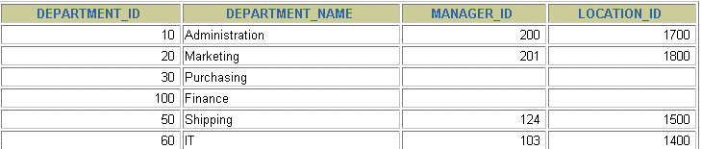
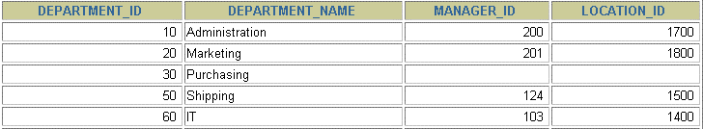
Removing a Row from a Table
DEPARTMENTS
Delete a row from the DEPARTMENTS table.

Slide 52
The DELETE Statement
Removal of all rows
Syntax –
DELETE FROM Tablename
Ex – DELETE FROM student;

Slide 53
The DELETE Statement
Removal of specific row(s)
Syntax –
DELETE FROM Tablename
Where Condition
Ex – DELETE FROM student
where branch =‘MCA’;

Slide 54
Difference Between Delete and Truncate
DELETE | TRUNCATE
Data can be recovered | Data cannot be recovered.
DML statement | DDL statement
DELETE does not do so | TRUNCATE releases the memory occupied by the records of the table

Slide 55
Operators
Arithmetic operators like +, - , *, /
Logical operators: AND, OR, NOT
Relational operators: =, <=, >=, < >, < , >

Slide 56
Retrieving All columns from a table
Syntax –
SELECT column1, column2,… FROM TableName;
Or
SELECT * FROM TableName;
Ex – SELECT * from student;
or
SELECT roll , name, branch from student;

Slide 57
Selecting Specific Columns
SELECT roll , name from student;
Note – write the column names you want separated by comma.

Slide 58
Empid | Name | Sal
1 | Aman | 20000
2 | Rohan | 15000
3 | Swati | 25000
List lout the employ details along with the annual salary
Select empid, name, sal, sal*12 from emp;

Slide 59
Defining a Column Alias
A column alias:
Renames a column heading
Is useful with calculations
Immediately follows the column name - there can also be the optional AS keyword between the column name and alias
Requires double quotation marks if it contains spaces or special characters or is case sensitive

Slide 60


Using Column Aliases
SELECT last_name AS name, commission_pct comm FROM employees;
SELECT last_name "Name", salary*12 "Annual Salary“ FROM employees;

Slide 61
Concatenation Operator
A concatenation operator:
Concatenates columns or character strings to other columns
Is represented by two vertical bars (||)
Creates a resultant column that is a character expression

Slide 62
Empid | F_name | L_name
1 | Arun | Kumar
2 | Asif | Ali
3 | Varun | Sharma
Select * from emp;
Arun Kumar
Asif Ali
Varun Sharma
Select Empid, F_name || L_name as “ Employee Name “ from emp;

Slide 63
Using the Concatenation Operator
SELECT First_name||Last_name AS "Employee Name"
FROM employees;

Slide 64
Literal Character Strings
A literal is a character, a number, or a date included in the SELECT list.
Date and character literal values must be enclosed within single quotation marks.
Each character string is output once for each row returned.

Slide 65
Name | City
Rajat | Delhi
Amit | Ghaziabad
Shubham | Ghaziabad
Rachna | Ahalabad
Rajat is from Delhi
Amit is from Gjaziabad
Shumham is from Ghaziabad
Rachna is from Ahlabad
Select name || “is from” || city from emp;

Slide 66
Roll | Name | College
1 | Aman | KIET
2 | Ayush | AKGEC
3 | Varun | KIET
Aman is a student of KIET
Ayush is a student of AKGEC
Varun is a student of KIET
Select name || “is a student of” || college from student;

Slide 67
Using Literal Character Strings
SELECT First_name ||' is from '||city
AS "Employee Details"
FROM employees;
Employee Details
Rajat is from Delhi
Amit is from Ghaziabad
Shubham is from Meerut
Rachna is from Ahlabad

Slide 68
Empid | Name | Dept
1 | Aman | MCA
2 | Rohan | MCA
3 | Akash | CS
4 | Rohit | IT
5 | Rihan | CS
6 | Shreya | ME
List out the dept names
Select distinct dept from emp;
MCA
CS
IT
ME

Slide 69
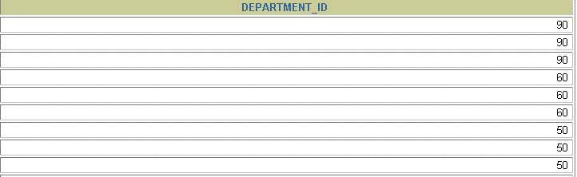
Duplicate Rows
The default display of queries is all rows, including duplicate rows.
SELECT department_id FROM employees;

Slide 70
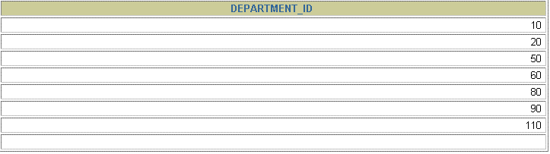
Eliminating Duplicate Rows
Eliminate duplicate rows by using the DISTINCT keyword in the SELECT clause.
SELECT DISTINCT department_id FROM employees;

Slide 71
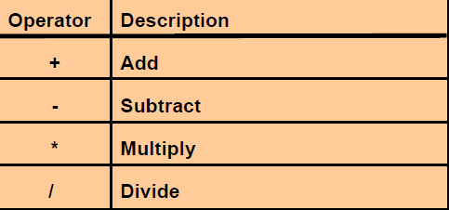
Arithmetic Expressions
Create expressions with number and date data by using arithmetic operators.

Slide 72
EmpId | Name | Salary
1 | Aman | 15000
2 | Varun | 20000
3 | Rakesh | 17000
Listout employee details along with annual salary
Select empid, Name, Salary, salary *12 as “Annual salary” from emp;
Listout employee details with gross salary if every employee is getting a commission of 300 Rs.
select empid, name, salary, salary +300 As “Gross Salary” from emp;

Slide 73
Roll | Name | S1 | S2 | S3 | S4 | S5
1 | Aman | 55 | 72 | 76 | 54 | 89
List out the student roll, name along with % of marks obtained.
List out the student roll, name along with the total marks obtained

Slide 74
Using Arithmetic Operators
SELECT First_Name, salary, salary + 300 as commission
FROM employees;
Exrecise – list out the employee names along with salary and annual salary of each employee.

Slide 75
Restricting and Sorting Data

Slide 76
Objectives
After completing this lesson, you should be able to do the following:
Limit the rows retrieved by a query
Sort the rows retrieved by a query

Slide 77
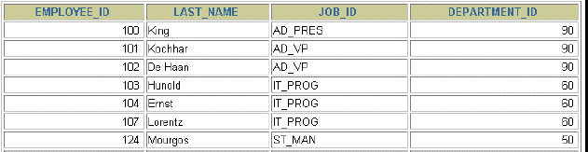

Limiting Rows Using a Selection
EMPLOYEES
“retrieve all employees
in department 90”

Slide 78
Limiting the Rows Selected
Restrict the rows returned by using the WHERE clause.
SELECT * FROM TableName
WHERE condition
The WHERE clause follows the FROM clause.
Ex- SELECT * FROM student
where branch = ‘MCA’;

Slide 79

Using the WHERE Clause
SELECT employee_id, last_name, job_id, department_id FROM employees
WHERE department_id = 90 ;
Or
SELECT * FROM employees
WHERE department_id = 90 ;

Slide 80
Character Strings and Dates
Character strings and date values are enclosed in single quotation marks.
Character values are case sensitive, and date values are format sensitive.
The default date format is DD-MON-YY.
Ex -SELECT *
FROM student
WHERE First_Name = ‘Rajat';

Slide 81
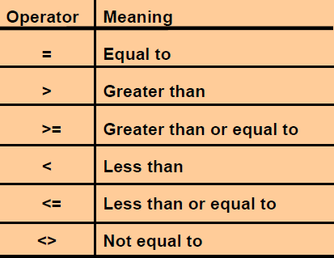
Comparison Conditions / Relational Operators

Slide 82
Using Comparison Conditions
SELECT last_name, salary
FROM employees
WHERE salary <= 3000;

Slide 83
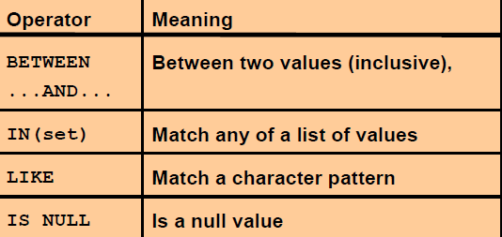
Other Comparison Conditions

Slide 84
Using the BETWEEN Condition
Use the BETWEEN condition to display rows based on a range of values.
SELECT last_name, salary FROM employees
WHERE salary BETWEEN 2500 AND 3500;
The BETWEEN operator allows the selection of rows that contain values within a specified lower and upper limit. The range coded after the word BETWEEN is inclusive.
Lower Limit
Upper Limit

Slide 85
Using the IN Condition
Use the IN membership condition to test for values in a list.
SELECT Roll, Name
FROM student
WHERE branch IN (‘MCA’,’CS’);

Slide 86
Using the LIKE Condition
Use the LIKE condition to perform wildcard searches of valid search string values.
Search conditions can contain either literal characters or numbers:
% denotes zero or many characters.
_ denotes one character.
Ex - SELECT Name
FROM student
WHERE Name LIKE ‘R%';

Slide 87
Roll | Name | Branch
1 | Rohan | MCA
2 | Aman | CS
3 | Aman | MCA
4 | Yash | MCA
5 | Ayushi | MCA
6 | Robin | CS
7 | Rabi | MCA
Select * from student where name = ‘Rohan’;
Select * from student where name like ‘R%’;
Select * from student where name like ‘Ro%’;
Select * from student where name like ‘R _ _ _’

Slide 88
Empid | Name
1 | Aman
2 | Ayush
3 | Anamika
Listout the employee details whose name is Aman
select * from emp where name = ‘Aman’;
Listout the employee details whose name is starts with A.
Select * from emp where name like ‘A%’;
Wildcard character
Select * from emp where name like ‘A_ _ _ ’

Slide 89
Using the LIKE Condition
SELECT Name
FROM student
WHERE Name LIKE '_o%';

Slide 90
Using the NULL Conditions
Test for nulls with the IS NULL operator.
Roll | Name | Branch | DOR
1 | Aman | MCA | 07-Aug-21
2 | Rohan | CS | -
3 | Prakash | MCA | -
4 | Mohan | IT | 12-Aug-21
Display the student details those who have not registered.
Select * from student where dor is null;
Select * from student where DOR is null;

Slide 91
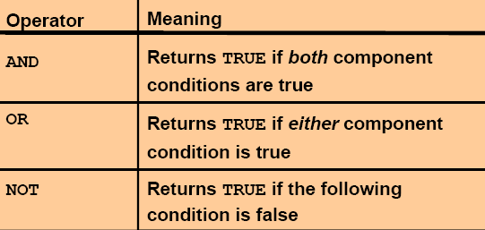
Logical Conditions

Slide 92
Roll | Name | Branch | DOR
1 | Aman | MCA | 07-Aug-21
2 | Rohan | CS | -
3 | Prakash | MCA | -
4 | Mohan | IT | 12-Aug-21
Display the student details those who are from MCA department and have not registered.
Select * from student where branch = ‘MCA’ AND DOR is null;

Slide 93
Using the AND Operator
AND requires both conditions to be true.
SELECT employee_id, last_name, job_id, salary
FROM employees
WHERE salary >=10000 AND job_id LIKE '%MAN%';

Slide 94
Roll | Name | Branch | DOR
1 | Aman | MCA | 07-Aug-21
2 | Rohan | CS | -
3 | Prakash | MCA | -
4 | Mohan | IT | 12-Aug-21
Display the student details those who are either from MCA or CS department and have not registered.
Select * from student where ((branch = ‘MCA’ OR branch = ‘CS’) AND DOR is null);

Slide 95
Using the OR Operator
OR requires either condition to be true.
SELECT employee_id, last_name, job_id, salary
FROM employees
WHERE salary >= 10000 OR job_id LIKE '%MAN%';

Slide 96
Using the NOT Operator
SELECT Roll, Name
FROM student
WHERE branch NOT IN (‘MCA’,’CS’);

Slide 97
ORDER BY Clause
Syntax – SELECT * from <Tablename>
ORDER BY <Columnname1><Columnname2> <[Sort Order]>
Sort rows with the ORDER BY clause
– ASC: ascending order, default
– DESC: descending order
The ORDER BY clause comes last in the SELECT statement.
Ex - SELECT last_name, department_id, salary
FROM employees
ORDER BY department_id;

Slide 98
Sorting in Descending Order
SELECT last_name, department_id, salary
FROM employees
ORDER BY department_id desc;

Slide 99
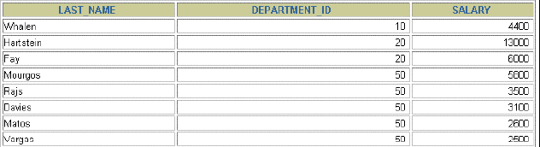
Sorting by Multiple Columns
The order of ORDER BY list is the order of sort.
SELECT last_name, department_id,salary
FROM employees
ORDER BY department_id, salary DESC;
You can sort by a column that is not in the SELECT list.

Slide 100
Roll | Name | Sec
1 | Aman | B
2 | Prakash | A
3 | Muskan | A
4 | Neha | C

Slide 101
Retrieval using ORDER BY
List the customers and their account numbers in the decreasing order of the Customer Last Name and increasing order of account numbers.
SELECT Cust_Last_Name, Cust_First_Name, Account_No
FROM Customer_Details
ORDER BY Cust_Last_Name DESC, Account_No;
Or
SELECT Cust_Last_Name, Cust_First_Name, Account_No
FROM Customer_Details
ORDER BY 1 DESC, 3;

Slide 102
SQL Functions

Slide 103
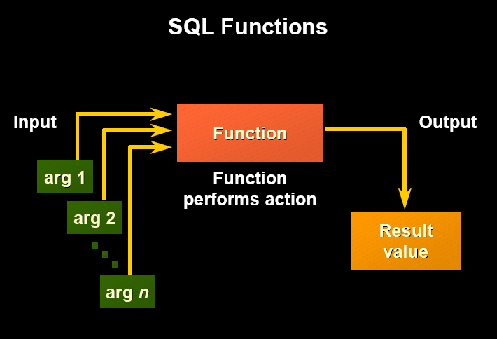

Slide 104
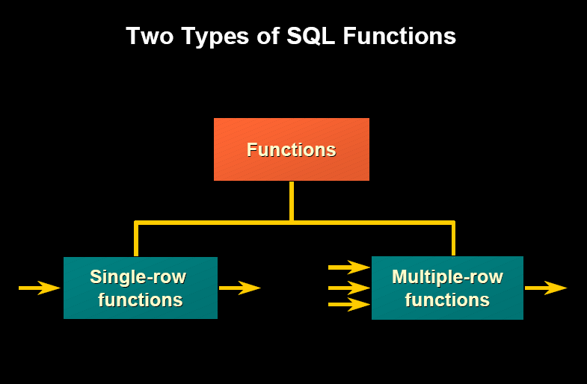

Slide 105
Scalar Functions(Single-Row Functions)
Single row functions:
Manipulate data items
Accept arguments and return one value
Act on each row returned
Return one result per row
Can be nested
Accept arguments which can be a column or an expression
Syntax - function_name [(arg1, arg2,......)]

Slide 106
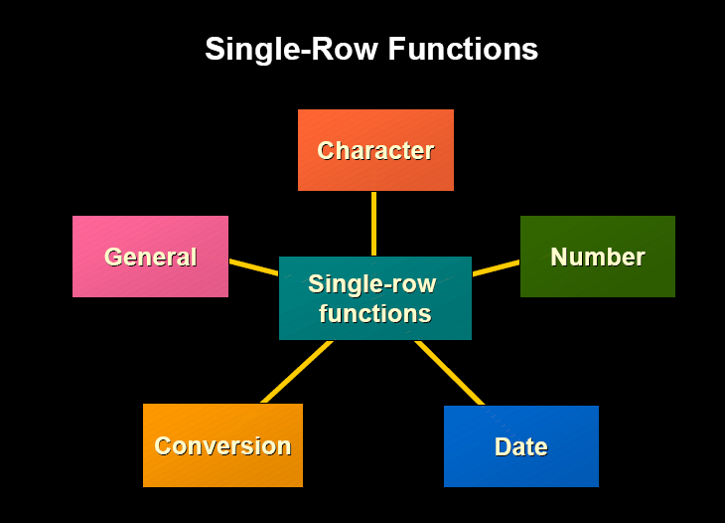
According to Data Types

Slide 107
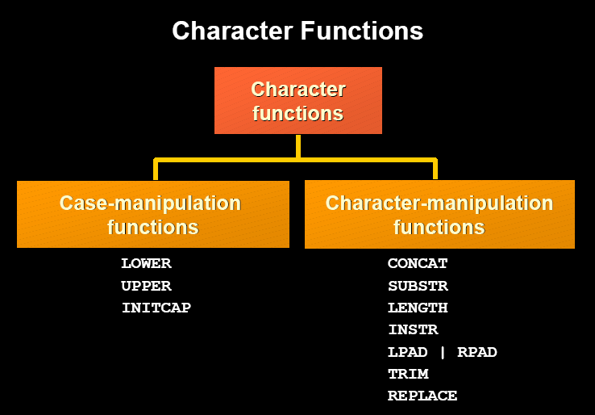

Slide 108
Case Manipulation Functions
LOWER – Returns char, with all letters in lowercase.
Syntax – LOWER(char)
Ex- SELECT LOWER(‘Aman Sharma’) from DUAL;
Ans – aman sharma.
SELECT Roll, LOWER(Name) from student ;

Slide 109
Roll | Name | Age
1 | aman jain | 23
2 | rahul kumar | 21
3 | neha jain | 21
1 Aman Jain 23
2 Rahul Kumar 21
Neha Jain 21
Select roll, initcap(Name) , age from student;

Slide 110
Case Manipulation Functions
UPPER – Returns char, with all letters in Uppercase.
Syntax – UPPER(char)
Ex- SELECT UPPER(‘Aman Sharma’) from DUAL;
Ans – AMAN SHARMA.
SELECT Roll, UPPER(Name) from student ;

Slide 111
Case Manipulation Functions
INITCAP – Returns char, with starting letter of the word in Uppercase.
Syntax – INITCAP(char)
Ex- SELECT INITCAP(‘aman sharma’) from DUAL;
Ans – Aman Sharma
SELECT Roll, INITCAP(Name) from student ;

Slide 112
Character Manipulation Function
SUBSTR – Returns a portion of characters, beginning at character m, and going up to character n. If n is omitted, the result returned is up to the last character in the string. The first position of char is 1.
Syntax – SUBSTR(<string>,<start_position>,[<length>])
Ex – select SUBSTR('HelloWorld',1,5) from dual;
Result - Hello

Slide 113
Roll | Name | Age
1 | Ram Kumar | 21
2 | Rabi kumar | 22
3 | Neha jain | 22
Display roll no and the first name of all the students.

Slide 114
Character Manipulation Function
CONCAT – concatenates two strings.
Syntax – CONCAT (<string1>,<string2>)
Ex – select CONCAT('Hello', 'World') from dual;
Result – HelloWorld
LENGTH –Returns the length of a word.
Syntax – LENGTH(word)
Ex – SELECT LENGTH(‘SHARANAM’) from dual;
Result – 8

Slide 115
Roll | F_Name | M_Name | S_Name
1 | Aman | Jain
2 | Rahul | Kumar | Sharma
3 | Arun | Kumar | Tripathi
4 | Kumari | Neha | Jain
Display roll, Name of all the students
1 Aman jain
2 Rahul Sharma
3 Rabi Kumar
Select roll concat(F_name, L_name) as “Name” from student

Slide 116
Roll | City | Street name | Block No | State
1 | Ghaziabad | Govindpuram | C-308 | UP
2 | Meerut | Paalav Puram | B-311 | UP
Display roll, Address of all the students

Slide 117
INSTR –Returns the location of a substring in a string.
Syntax – INSTR(<string1>,<string2>,[<startposition>],[<nth_appearance>])
Where string1 is the string to search.
String2 is the substring to search for in string1
startposition is the position in string1 where the search will start.
If omitted the default is 1.
If the startposition is negative it will start from the end & go towards first.
nth_appearance is the nth appearance of string2, if omitted default is 1.
Ex – SELECT INSTR(‘SCT on the net’,’t’) from dual;
Result – 8
SELECT INSTR(‘SCT on the net’,’t’,1,2) from dual;
Result - 14

Slide 118
ASCII – Returns the ASCII code of the character. If more than one character is entered, the function will return the value of the first character and ignore all of the characters after the first.
Syntax - ASCII(<single_character>)
Ex – Select ASCII(‘a’) “ASCII1”, ASCII(‘A’) “ASCII2” from dual;
Result –
ASCII1 ASCII2
----------------------------------
97 65

Slide 119
LPAD – Returns char1, left-padded to length n with the sequence of characters specified in char2. If char2 is not specified Oracle uses blanks by default.
Syntax – LPAD(char1,n,[char2])
Ex – SELECT LPAD(‘page 1’, 10,’*’) “lpad” from dual;
Result –
LPAD
----------
****page 1

Slide 120
Roll | Name
1 | Aman
2 | Roahn
3 | Neha
######Aman
********Rohan
********Neha

Slide 121
RPAD – Returns char1, Right-padded to length n with the sequence of characters specified in char2. If char2 is not specified Oracle uses blanks by default.
Syntax – RPAD(chat1,n,[char2])
Ex – SELECT RPAD(‘page 1’, 10,’*’) “rpad” from dual;
Result –
RPAD
----------
page 1****

Slide 122
TRIM – Removes all specified characters either from the beginning or the ending of a string.
Syntax – TRIM( [ leading| trailing | both [<trim_character> FROM]] <string1> )
Where,
leading removes trim_character from the front of string1.
trailing removes trim_character from the end of string1.
both removes trim_character from the front and end of string1.
If nothing is mentioned default is both.
Trim_charcter is the character that will be removed from string1.
If there is no trim_character, the trim function will remove
All leading and trailing spaces from string1.

Slide 123
Insert into emp values( 1, ‘ Aman Kumar ‘);

Slide 124
Ex –
1. select TRIM(‘ Hansel ‘) from dual;
Result – Hansel
2. Select TRIM(leading ‘x’ from ‘ xxxxHanselxxx’) from dual;
Result – Hanselxxx
3. Select TRIM(trailing ‘x’ from ‘ xxxxHanselxxx’) from dual;
Result – xxxxHansel
4. Select TRIM(both ‘x’ from ‘ xxxxHanselxxx’) from dual;
Result – Hansel

Slide 125
Lab Exercise
EMPLOYEE
Empcode | Empname
E1 | 001Rajkumar
E2 | Ramkumar002
E4 | Ravikumar003
1. Write SQL Query to fetch the result as shown
Empcode | Empname
E1 | Rajkumar
E2 | Ramkumar
E4 | Ravikumar

Slide 126
Number Functions
ABS – Returns the absolute value of n.
Syntax – ABS(n)
Ex – select ABS(-15) from dual;
Result – 15
POWER – Returns m raised to the nth power. n must be integer, else an error is returned.
Syntax – POWER(m , n)
Ex- select POWER(3,2) from dual;
Result - 9

Slide 127
Number Functions
ROUND – Returns n, rounded to m places to the right of a decimal point. If m is omitted, n is rounded to 0 places. m must be an integer
Syntax – ROUND(n,[m])
Ex – select ROUND(15.19,1) from dual;
Result – 15.2
1. select ROUND(15.19,2) from dual;
Result – 15.19
2. select ROUND(15.19) from dual;
Result – 15
3. select ROUND(15.91) from dual;
Result – 16

Slide 128
Number Functions
SQRT– Returns square root of n.
Syntax – SQRT(n)
Ex- select SQRT(25) from dual;
Result – 5
EXP – Returns e, raised to the nth power where e = 2.718281833
Syntax – EXP(n)
Ex – select EXP(5) from dual;
Result – 148.413159

Slide 129
Number Functions
MOD – Returns the remainder after division.
Syntax – MOD(m , n)
SELECT MOD(15,7) from dual;
Result = 1
SELECT MOD(15,-7) from dual;
Result = 1
SELECT MOD(-15,7) from dual;
Result = -1
SELECT MOD(-15,-7) from dual;
Result = -1

Slide 130
Number Functions
TRUNC – Returns a number truncated to a certain number of decimal places. If decimal_places is omitted , it will be truncated the number to 0 decimal places.
Syntax – TRUNC(number,[decimal_places])
Ex – select trunc(9.732) from dual;
Result – 9
select trunc(9.732,1) from dual
Result – 9.7

Slide 131
Number Functions
FLOOR – Returns the largest integer value that is equal to or less than a number.
Syntax – FLOOR(n)
Ex - select FLOOR(88.9) from dual;
Relult – 88

Slide 132
Number Functions
CEIL - Returns the smallest integer value that is equal to or greater than a number.
Syntax – CEIL(n)
Ex - select CEIL(88.9) from dual;
Relult – 89
select CEIL(88.1) from dual;
Result - 89

Slide 133
Number Functions
GREATEST – Returns the greatest value in a list of expressions.
Syntax – GREATEST(expr1,expr2,expr3,…..expr_n)
Ex – select Greatest(4,5,17) from dual;
Result – 17
LEAST - Returns the least value in a list of expressions
Syntax – LEAST(expr1,expr2,expr3,…..expr_n)
Ex – select LEAST(4,5,17) from dual;
Result - 4

Slide 134
DECODE - DECODE function has the functionality of an IF-THEN-ELSE statement.
Syntax - decode(expression , search , result [, search , result]... [, default] )
expression is the value to compare.
search is the value that is compared against expression.
result is the value returned, if expression is equal to search.
default is optional. If no matches are found, the decode will return default. If default is omitted, then the decode statement will return null (if no matches are found).

Slide 135
SELECT supplier_name,
decode(supplier_id, 10000, 'IBM',
10001, 'Microsoft',
10002, 'Hewlett Packard',
'Gateway') result
FROM suppliers;
IF supplier_id = 10000 THEN result := 'IBM';
ELSIF supplier_id = 10001 THEN result := 'Microsoft';
ELSIF supplier_id = 10002 THEN result := 'Hewlett Packard';
ELSE result := 'Gateway';
END IF;

Slide 136
The records in the table are as given below
Sname | Division
A | 1
B | 2
C | 3
D | 0
Write the SQL query to print the result as given below
Sname | Division
A | First
B | Second
C | Third
D | Fail

Slide 137
select sname,
decode(division, 1, ‘First’,
2, ‘Second’,
3, ‘Third’,
‘Fail’)
from result;

Slide 138
The records in the table are as given below
Sname | Salary
A | 10000
B | 5200
C | 4500
D | 12350
Write the SQL query to print the result as given below
Sname | Group
A | HI
B | MI
C | LI
D | HI
Rule is
If salary < 5000 - LI
If salary >= 5000 && < 10000 - MI
If salary >= 10000 - HI

Slide 139
Select sname,
Decode(salary, salary<

Slide 140
Lab Assignment
Sname | Marks
Raj | 65
Amit | 32
Sanjay | 45
Rohit | 40
Anil | 35
O/P1: Pass marks are 35.
O/P2: 1st- >=60, 2nd-<60- >=45, 3rd-<45- >=35, Fail- <35.
O/P -1
O/P -2
Sname | Result
Raj | Pass
Amit | Fail
Sanjay | Pass
Rohit | Pass
Anil | Pass
Sname | Result
Raj | First
Amit | Fail
Sanjay | Second
Rohit | Third
Anil | Third

Slide 141
Lab Exercise
EMP_ID | F_NAME | M_NAME | L_NAME | JOB_ID
E1 | Rohan | Prasad | Sharma | Sa_REP
E2 | Jeetndra |  | Tiwari | Mk_REP
E3 | Reena |  | Singh | Mgr
Write SQL query to print the em_id, Name of those employees whose job_id contains ‘REP”
EMP_ID | NAME | JOB_ID
E1 | Rohan Prasad Sharma | Sa_REP
E2 | Jeetndra Tiwari | Mk_REP

Slide 142
REPLACE (string , serach_string , replacement_string)
REPLACE - REPLA CE returns char with every occurrence of search_string replaced with replacement_string. If replacement_string is omitted or null, then all occurrences of search_string are removed. If search_string is null, then char is returned.
Example - The following example replaces occurrences of J with BL:
SELECT REPLACE('JACK and JUE','J','BL') "Changes" FROM DUAL;
Changes
--------------
BLACK and BLUE

Slide 143
Replace Example
>select replace(‘thin and that’, ‘th’, ‘B’) from dual;
o/p-> Bin and Bat
>select replace(‘thin and that’, ‘that’, ‘cat’) from dual;
o/p-> thin and cat

Slide 144
Translate (string , from_string , to_string)
TRANSLATE returns expr with all occurrences of each character in from_string replaced by its corresponding character in to_string.
REPLACE lets you substitute a single string for another single string
TRANSLATE lets you make several single-character, one-to-one substitutions in one operation.
Ex- Select TRANSLATE(‘1sct523’, ‘123’,’7a9’) from dual;
Result – 7sct5a9

Slide 145
Translate Example
>select translate(‘this and that’, ‘this’, ‘ABCD’) from dual;
o/p-> ABCD and ABaA
>select translate(‘this and that’, ‘tad’, ‘AB’) from dual;
o/p -> Ahis Bn AhBA

Slide 146
Syntax - SOUNDEX(string)
SOUNDEX returns a character string containing the phonetic representation of char. This function lets you compare words that are spelled differently, but sound alike in English.
Example – Select * from emp where soundex(surname) = soundex(‘agarwal’);

Slide 147
Date Functions

Slide 148
Date Function
CURRENT_DATE - returns the current date
Ex- select current_date from dual;
Default format – dd-mon-yy
SYSDATE - returns the current date and time set for the operating system on which the database resides

Slide 149
Date Function
Syntax –
ADD_MONTHS (datevalue, integer)
Returns date after adding the number of months specified in the function.
Ex- select dosell, add_months(dosell,2) “Expiry Date” from selling;
select add_months(‘21-jun-12’, -3) from dual;
Result – 21 – MAR - 12

Slide 150
Date Function
LAST_DAY – Returns the last date of the month specified with the function.
Syntax – LAST_DAY(date)
Ex – select last_day(sysdate) from dual;
Result – 30-AUG-12

Slide 151
Date Function
NEXT_DAY – Returns the date of the first weekday named by specific day that is after the date named by date.
Syntax – NEXT_DAY(datevalue, specific day)
This example returns the date of the next Tuesday after February 2, 2001:
SELECT NEXT_DAY('02-FEB-2001','TUESDAY') "NEXT DAY" FROM DUAL;
NEXT DAY
-----------
06-FEB-2001

Slide 152
MONTHS_BETWEEN – Returns number of months between d1 & d2.
Syntax - MONTHS_BETWEEN(d1,d2)
If d1 is later than d2, then the result is positive. If d1 is earlier than d2, then the result is negative. If d1 and d2 are either the same days of the month or both last days of months, then the result is always an integer. Otherwise Oracle Database calculates the fractional portion of the result based on a 31-day month and considers the difference in time components d1 and d2.
Ex- select months_between(‘02-FEB-92’,’02-JAN-92’) from dual;
Ans - 1

Slide 153
EXTRACT – Returns a value extracted from a date.
Syntax – EXTRACT(year| month|day from date)
Select extract(year from sysdate) from dual;
Select extract(month from sysdate) from dual;
Select extract(day from sysdate) from dual;

Slide 154
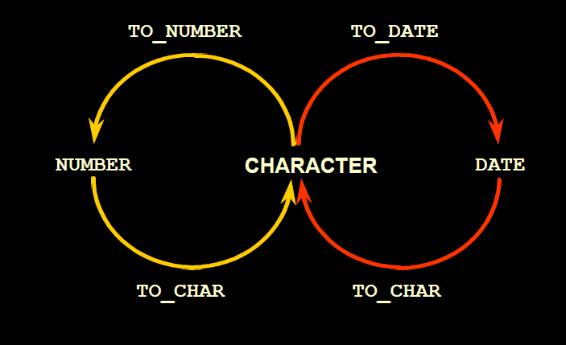
Conversion Function

Slide 155
Using the TO_CHAR Function with Dates
Syntax -TO_CHAR(date, ‘format_model‘)
The format model:
Must be enclosed in single quotation marks and is case sensitive
Can include any valid date format element
Is separated from the date value by a comma

Slide 156
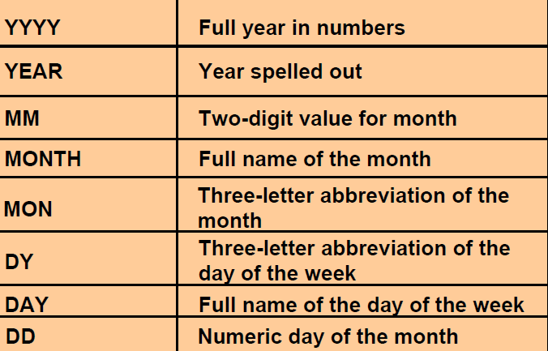
Elements of the Date Format Model
1995, 2012
Twenty Twelve
01 - 12
January - DEcember
Jan , Feb, Mar etc.
Sun, Mon etc
Sunday, Monday etc.
01 - 31

Slide 157
TO_CHAR Function with Date
Example
Select ENAME,TO_CHAR(hiredate, ‘DD/MM/YYYY’) from emp;
Select ENAME,TO_CHAR(hiredate, ‘DD/MONTH/YYYY’) from emp;
Select ENAME,TO_CHAR(hiredate, ‘DD/MM/YY’) from emp;
Select ENAME,TO_CHAR(hiredate, ‘DD/MM/YEAR’) from emp;

Slide 158
Suffices to use with to_char()
Th ddth 1st/24th
Sp ddsp one/ two
Spth ddspth first/ second
“String”

Slide 159
TO_CHAR Function with Date
Example
SELECT last_name,
TO_CHAR(hire_date, ‘DD Month YYYY ') AS HIREDATE
FROM employees;
select ename, salary,
to_char(dob, ‘dd/mm/yyyy hh:mi A.M.’),
to_char(doj, ‘dd/mm/yyyy’) from emp;

Slide 160
Date Functions
O/p : Raj was born on 21st of May in the year Nineteen seventy at 10:30 A.M.
Select ename|| ‘was born on’ ||
to_char(dob, ‘ddth’) || ‘of’ ||
to_char(dob, ‘month’) || ‘in the year’ || to_char (dob, ‘year’) || ‘at’ ||
to_char(dob, ‘hh:mi A.M.’) from emp;

Slide 161
Date Functions
O/p : Raj was born on 21st of May in the year Nineteen seventy at 10:30 a.m..
> Select ename|| ‘was born on’ || to_char(dob, ‘ddth “of” month “in the year” year “at” hh:mi a.m.’) from emp;

Slide 162
Assignments
We have one table emp containing ename, dob, doj. Print “Happy Birthday” on their birthdays.
Calculate and print the current age of the employees.

Slide 163
Using the TO_DATE function
Convert a character string to a date format using the TO_DATE function:
Syntax -TO_DATE(char[, ‘format_model’])
Ex –
1. insert into emp(ename, sal, dob, doj) values(‘Raj’, 10000, to_date(‘21/05/1970 10:30 A.M.’, ‘dd/mm/yyyy HH:MI A.M.’), to_date(‘21-June-10’, ‘dd-month-yy));

Slide 164
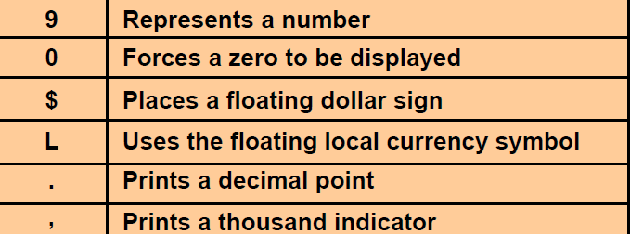
Using the TO_CHAR Function with Numbers
TO_CHAR(number, ‘format_model')
You can use the TO_CHAR function to display a number value as a character.

Slide 165
TO_CHAR Function with Numbers
Example –
SELECT ENAME,TO_CHAR(salary, '$99,999.00') SALARY FROM employees

Slide 166
Using the TO_NUMBER function
Syntax - TO_NUMBER (n)
Converts n , a CHARACTER value expressing a number, to a NUMBER datatype.
Ex – UPDATE ACCT_MSTR set curbal = curbal + TO_NUMBER (SUBSTR( ‘$100’, 2 , 3));

Slide 167
Aggregate Functions

Slide 168
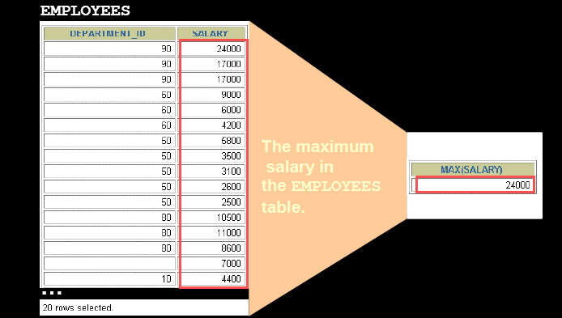
What Are Group Functions?
Group functions operate on sets of rows to give one result per group.

Slide 169
Types of Group Functions
AVG
COUNT
MAX
MIN
STDDEV
SUM
VARIANCE

Slide 170
Aggregate Functions
AVG
Syntax – AVG(column name)
Returns an average value of values stored under ‘column name’, ignoring null values in a column
Ex -
SELECT avg(salary) “Average Salary” from emp;

Slide 171
Aggregate Functions
MIN
Syntax – MIN(<expr>)
MIN returns minimum value of expr
Ex-
SELECT MIN(salary) “Minimum Salary” from emp;

Slide 172
Aggregate Functions
MAX
Syntax – MAX(<expr>)
MAX returns maximum value of expr
Ex-
SELECT MAX(salary) “Maximum Salary” from emp;

Slide 173
Aggregate Functions
SUM
Syntax – SUM(<expr>)
SUM returns the sum of the value of expr
Ex-
SELECT SUM(salary) “Total Sum” from emp;

Slide 174
Aggregate Functions
COUNT
Syntax – COUNT([<DISTINCT>|<ALL>]<expr>)
COUNT returns the number of rows where expr is not null.
EX-
SELECT count(empid) “Total no. of Employee” from emp;
Note – COUNT(*) – Returns the number of rows in the table, including duplicates and those with nulls.

Slide 175
Aggregate Functions
STDDEV
Syntax – STDDEV([<DISTNICT>|<ALL>]<expr>)
STDDEV returns the sample standard deviation of expr, a set of numbers.
Ex –
SELECT STDDEV(salary) "Deviation" FROM employees;

Slide 176
Aggregate Functions
VARIANCE
Syntax – VARIANCE([<DISTNICT>|<ALL>]<expr>)
VARIANCE returns the variance of expr.
Ex-
SELECT VARIANCE(salary) “Variance" FROM employees;

Slide 177
Example Aggregate Function
SELECT AVG(salary), MAX(salary), MIN(salary), SUM(salary) FROM employees WHERE job_id LIKE '%REP%';
SELECT MIN(hire_date), MAX(hire_date)
FROM employees;

Slide 178
Example Aggregate Function
List out the total number of employees working in MCA depertment whose deptIid is 50.
SELECT COUNT(*) FROM employees
WHERE department_id = 50;
Listout how many departments are there
SELECT COUNT(DISTINCT department_id)
FROM employees;

Slide 179
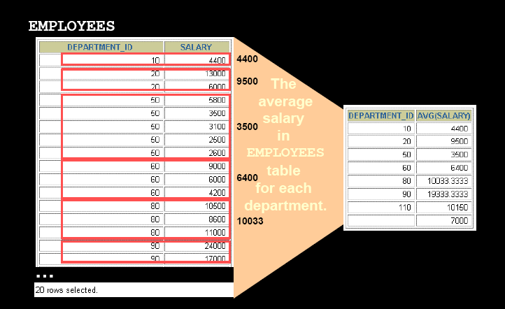
Creating Groups of Data

Slide 180
Creating Groups of Data: The GROUP BY Clause Syntax
SELECT Column1,Column2,….,
Aggregate_Function(Expression)
FROM TableName
WHERE Condition
GROUP By Column1,Column2,….
Note - Divide rows in a table into smaller groups by using the GROUP BY clause.

Slide 181
Using the GROUP BY Clause
All columns in the SELECT list that are not in group functions must be in the GROUP BY clause.
Ex –
SELECT department_id, AVG(salary) FROM employees GROUP BY department_id ;

Slide 182
Using the GROUP BY Clause
The GROUP BY column does not have to be in the SELECT list.
Ex –
SELECT AVG(salary) FROM employees
GROUP BY department_id ;

Slide 183
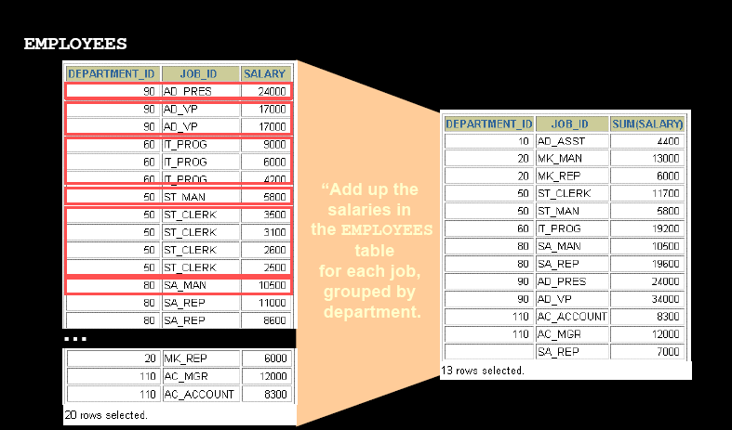
Grouping by More Than One Column

Slide 184
Using the GROUP BY Clause on Multiple Columns
SELECT dept_id, job_id, SUM(salary)
FROM employees
GROUP BY dept_id, job_id ;

Slide 185
Illegal Queries Using Group Functions
Any column or expression in the SELECT list that is not an aggregate function must be in the GROUP BY clause.
SELECT department_id, COUNT(last_name)
FROM employees;
SELECT department_id, COUNT(last_name)
*
ERROR at line 1:
ORA-00937: not a single-group group function
Column missing in the Group By clause

Slide 186
Illegal Queries Using Group Functions
You cannot use the WHERE clause to restrict groups.
• You use the HAVING clause to restrict groups.
• You cannot use group functions in the WHERE clause.
SELECT dept_id, AVG(salary)
FROM employees
WHERE AVG(salary) > 8000
GROUP BY department_id;
WHERE AVG(salary) > 8000
*
ERROR at line 3:
ORA-00934: group function is not allowed here
Cannot use the WHERE clause to restrict groups

Slide 187
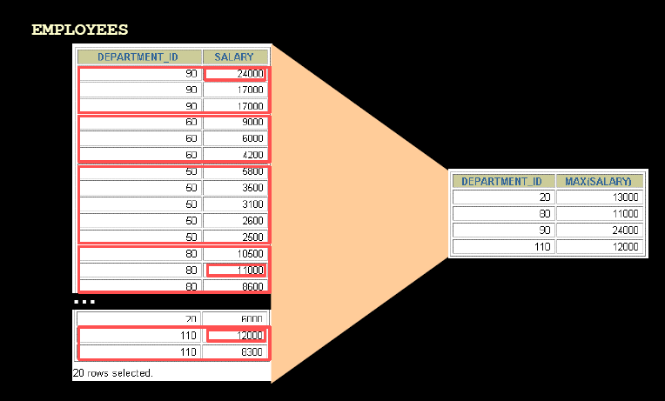
Excluding Group Results

Slide 188
Excluding Group Results: The HAVING Clause
Use the HAVING clause to restrict groups:
1. Rows are grouped.
2. The group function is applied.
3. Groups matching the HAVING clause are displayed.
SELECT Column1,Column2,….,
Aggregate_Function(Expression)
FROM TableName
WHERE Condition
GROUP By Column1,Column2,….
HAVING group_Condition
ORDER BY column

Slide 189
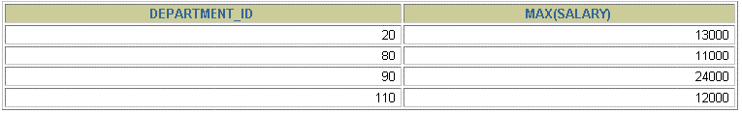
Using the HAVING Clause
SELECT department_id, MAX(salary)
FROM employees
GROUP BY department_id
HAVING MAX(salary)>10000 ;

Slide 190

Using the HAVING Clause
SELECT job_id, SUM(salary) PAYROLL
FROM employees
GROUP BY job_id
HAVING SUM(salary) > 13000
ORDER BY SUM(salary);

Slide 191
Nesting Group Functions
Display the maximum average salary.
SELECT dept_id, MAX(AVG(salary))
FROM employees
GROUP BY dept_id;

Slide 192
Assignment
There is a table named ITEM with attributes (ItemNo., ItemName,Qty, UnitPrice, Pdate)
Write query for
List minimum UnitPrice. From item table
2. List maximum UnitPrice. From item table
3. List the total number of items in the item table.

Slide 193
Assignment Answer
Ans 1 – select MIN(unitprice) from item;
Ans 2 – select MAX(unitprice) from item;
Ans 3 – select count(*) from item;

Slide 194
Assignment
There is a Bill Table with attributes (BillNo, Billdate, amount)
Write SQL query to
List out the number of unique dates on which bill has been generated.
List out the unique dates on which bill has been generated.

Slide 195
Assignment Answer
Ans – select count(distinct Billdate) “Billdate” from Bill;
Ans – select distinct Billdate “Bill Date” from Bill;

Slide 196
SUB QUERIES

Slide 197
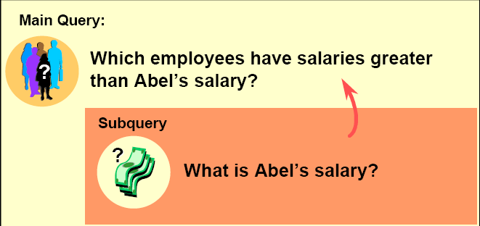
Using a Sub-query to Solve a Problem
Who has a salary greater than Abel’s?

Slide 198
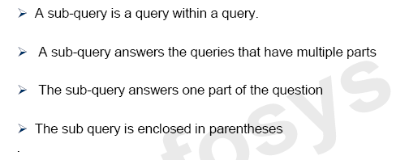

Sub Queries

Slide 199
Sub-query Syntax
Outer Query
SELECT select_list
FROM table
WHERE expr operator
(SELECT select_list
FROM table);
Inner Query
Inner Query is independent of Outer Query.
Inner Query is executed first & the results are stored.
The result of the sub-query is used by the main query (outer query).

Slide 200
Using a Subquery
SELECT last_name, salary
FROM employees
WHERE salary >
(SELECT salary
FROM employees
WHERE last_name = 'Abel');

Slide 201
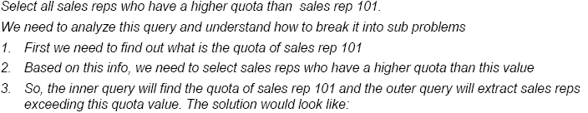
Example
SELECT Rep_name
FROM SalesReps
WHERE Quota >
(SELECT Quota
FROM SalesReps
WHERE EmpId = 101);

Slide 202
Guidelines for Using Sub-queries
Enclose sub-queries in parentheses.
Place sub-queries on the right side of the comparison condition.
Use single-row operators with single-row sub-queries and use multiple-row operators with multiple-row sub-queries.

Slide 203
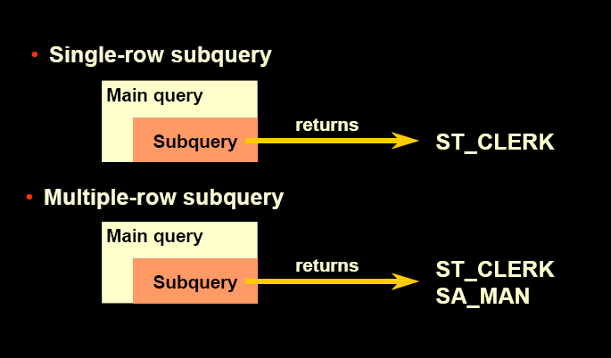
Types of Sub - queries

Slide 204
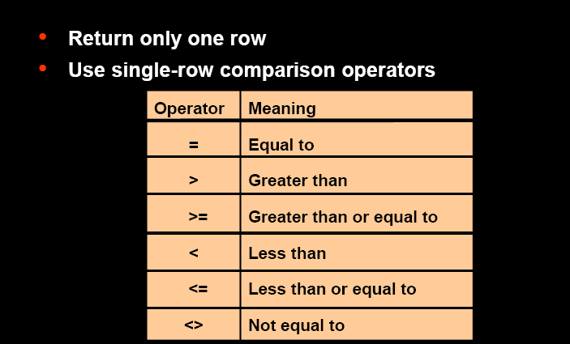
Single-Row Sub-queries

Slide 205
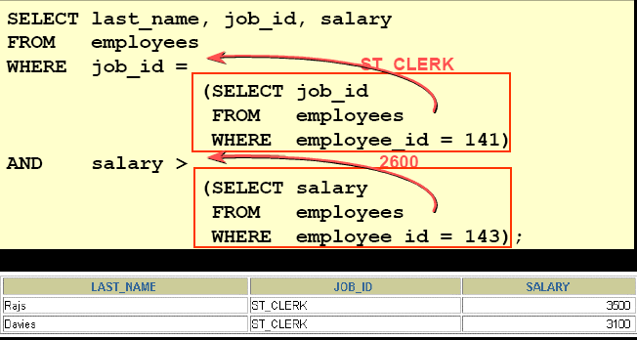
Executing Single-Row Subqueries

Slide 206
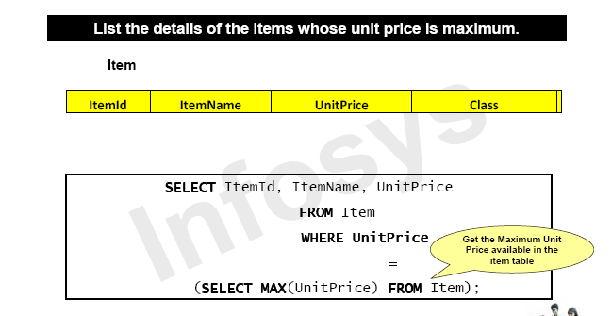
Executing Single-Row Sub queries

Slide 207

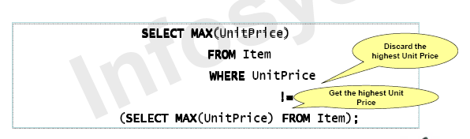
Executing Single-Row Sub queries

Slide 208

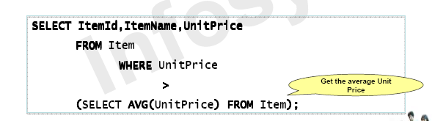
Executing Single-Row Sub queries

Slide 209
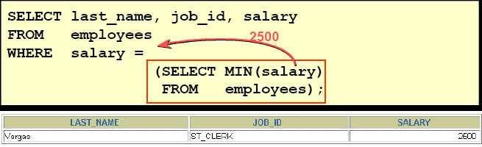
Using Group Functions in a Subquery

Slide 210
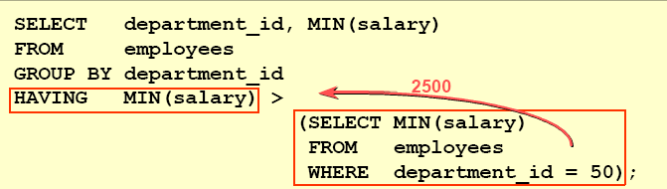
The HAVING Clause with Subqueries
The Oracle server executes subqueries first.
• The Oracle server returns results into the HAVING clause of the main query.

Slide 211
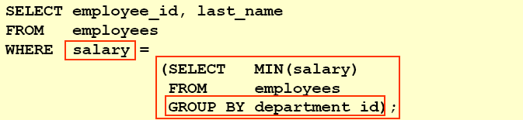
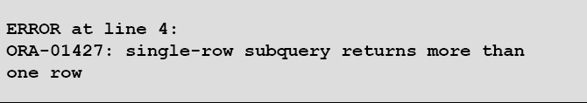
What is Wrong with this Statement?

Slide 212
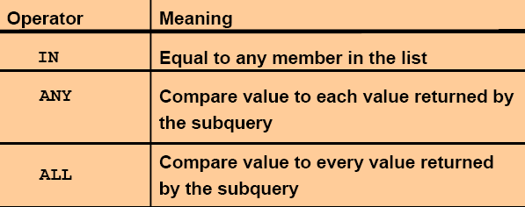
Multiple-Row Subqueries
Return more than one row
Use multiple-row comparison operators

Slide 213
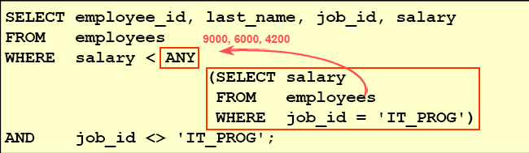
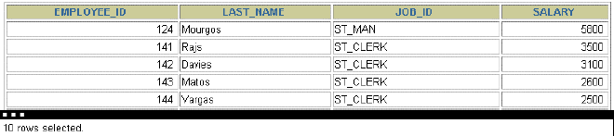
Using the ANY Operator in Multiple-Row Sub-queries

Slide 214
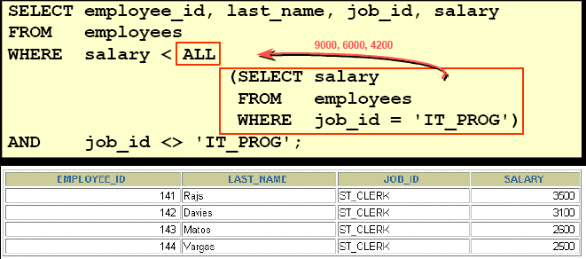
Using the ALL Operator in Multiple-Row Sub-queries

Slide 215

Using The IN Operator
List out the customer names who purchased some items.
Select CustomerName frorm Customer
Where CustomerId in
(select CustomerId from CustomerPurchase)

Slide 216
Exists Vs Not Exists
The Exists Keyword is used to check whether a sub-query produces any row(s) of results.
If the query following the EXISTS returns at least one row, the EXISTS returns TRUE.
If the query following the EXISTS returns no row, the EXISTS returns False.

Slide 217

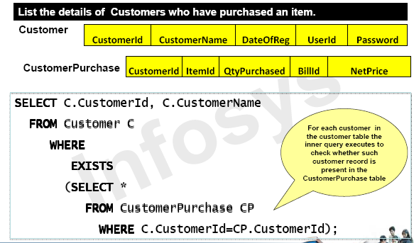

Slide 218

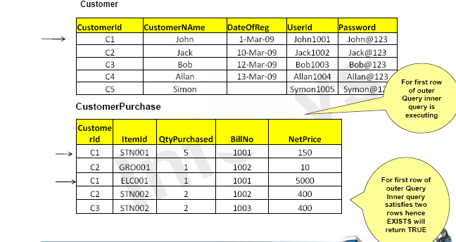

Slide 219

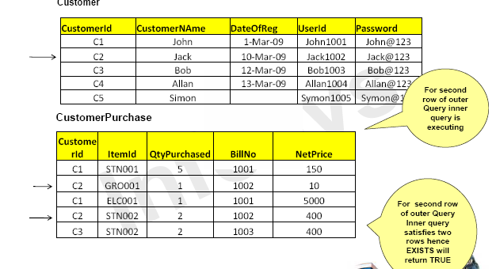

Slide 220

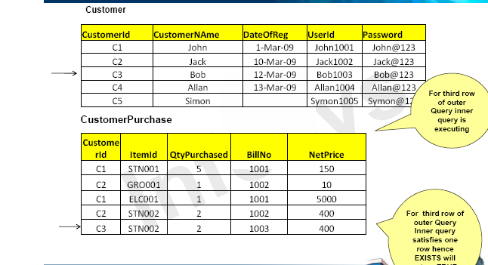

Slide 221



Slide 222



Slide 223


Slide 224


Slide 225


Slide 226


Slide 227


Slide 228


Slide 229


Slide 230


Slide 231

Using the & Substitution Variable
Use a variable prefixed with an ampersand (&) to prompt the user for a value.

Slide 232

Character and Date Values with Substitution Variables
Use single quotation marks for date and character values.

Slide 233
Specifying Column Names, Expressions, and Text
Use substitution variables to supplement the following:
WHERE conditions
ORDER BY clauses
Column expressions
Table names
Entire SELECT statements

Slide 234

Specifying Column Names, Expressions, and Text

Slide 235

Using the DEFINE Command with & Substitution Variable
Create the substitution variable using the DEFINE command.
Use a variable prefixed with an ampersand (&) to substitute the value in the SQL statement.

Slide 236

Using the && Substitution Variable
Use the double-ampersand (&&) if you want to reuse the variable value without prompting the user each time.

Slide 237


Using the VERIFY Command
Use the VERIFY command to toggle the display of the substitution variable, before and after SQL*Plus replaces substitution variables with values.

Slide 238

Creating a Table by Using a Sub-query Syntax
Create a table and insert rows by combining the CREATE TABLE statement and the AS subquery option.
Match the number of specified columns to the number of subquery columns.
Define columns with column names and default values.

Slide 239

Creating a Table by Using a Subquery

Slide 240
Constraints

Slide 241
Objectives
After completing this lesson, you should be able to do the following:
Describe constraints
Create and maintain constraints

Slide 242
What are Constraints?
Constraints enforce rules at the table level.
Constraints prevent the deletion of a table if there are dependencies.
The following constraint types are valid:
NOT NULL
UNIQUE
PRIMARY KEY
FOREIGN KEY
CHECK

Slide 243
NOT NULL Constraint
The NOT NULL constraint enforces a column to NOT accept NULL values.
This enforces a field to always contain a value, which means that you cannot insert a new record, or update a record without adding a value to this field.

Slide 244

The NOT NULL Constraint
Ensures that null values are not permitted for the column:

Slide 245

The NOT NULL Constraint

Slide 246
UNIQUE Constraint
The UNIQUE constraint ensures that all values in a column are different.
In other words all the values in a column are unique.

Slide 247

UNIQUE Constraint

Slide 248

The UNIQUE Constraint

Slide 249
PRIMARY KEY Constraint
The PRIMARY KEY constraint uniquely identifies each record in a database table.
Primary keys must contain UNIQUE values, and cannot contain NULL values.
A table can have only one primary key, which may consist of single or multiple fields.
When more than one field is used for making primary key, than it is called composite primary key.

Slide 250

The PRIMARY KEY Constraint

Slide 251
Primary Key at row level
CREATE TABLE Persons ( ID number(5) PRIMARY KEY, LastName varchar(255) NOT NULL, FirstName varchar(255) NOT NULL, Age number(3) NOT NULL );

Slide 252

The PRIMARY KEY Constraint at Table Level

Slide 253
Example of composite primary key
CREATE TABLE Persons ( ID number(5), LastName varchar2(255) , FirstName varchar2(255), Age int, CONSTRAINT PK_Person PRIMARY KEY (ID,LastName) );

Slide 254
Primary Key Constraint | Unique Constraint
You can have only one PRIMARY KEY constraint per table. | You can have many UNIQUE constraints per table.
Can not allow NULL values | Can allow NULL values

Slide 255
CHECK Constraint
The CHECK constraint is used to limit the value range that can be placed in a column.
If you define a CHECK constraint on a single column it allows only certain values for this column.
If you define a CHECK constraint on a table it can limit the values in certain columns based on values in other columns in the row.

Slide 256
Check Constraint at row level
CREATE TABLE Persons ( ID number(5) NOT NULL, LastName varchar2(255) NOT NULL, FirstName varchar2(255), Age number(3) CHECK (Age>=18) );

Slide 257
Check Constraint at Table level
CREATE TABLE Persons ( ID number(5) NOT NULL, LastName varchar(255) NOT NULL, FirstName varchar(255), Age int, City varchar(255), CONSTRAINT CHK_Person CHECK (Age>=18 AND City=‘Mumbai') );

Slide 258

The CHECK Constraint

Slide 259
DEFAULT Constraint
The DEFAULT constraint is used to provide a default value for a column.
The default value will be added to all new records IF no other value is specified.

Slide 260
Example DEFAULT
CREATE TABLE EMP ( ID number(5) NOT NULL, LastName varchar(255) NOT NULL, FirstName varchar(255) NOT NULL, Age number(3),
Gender char(1) DEFAULT ‘M’, City varchar(255) DEFAULT ‘Delhi' );

Slide 261
DEFAULT on ALTER TABLE
To create a DEFAULT constraint on the "City" column when the table is already created, use the following SQL:
ALTER TABLE EMP MODIFY City DEFAULT ‘Delhi';

Slide 262
DROP a DEFAULT Constraint
To drop a DEFAULT constraint, use the following SQL:
ALTER TABLE EMP ALTER COLUMN City DROP DEFAULT;

Slide 263


Slide 264


Slide 265
FOREIGN KEY Constraint
A FOREIGN KEY is a key used to link two tables together.
A FOREIGN KEY is a field (or collection of fields) in one table that refers to the PRIMARY KEY in another table.
The table containing the foreign key is called the child table, and the table containing the primary key is called the referenced or parent table.

Slide 266
CUSTOMER
CID
CNAME
Address
ORDERS
OID
QTY
CID

Slide 267
CREATE TABLE Customer
( CID number(5) primary key,
CNAME varchar2(35),
Address varchar2(30)
);
CREATE TABLE Orders
( OID number(5) primary key,
QTY number(3),
CID number(5) FOREIGN KEY REFERENCES Customer(CID)
);

Slide 268

The FOREIGN KEY Constraint

Slide 269

The FOREIGN KEY Constraint
Defined at either the table level or the column level:

Slide 270


Slide 271


Slide 272


Slide 273



Slide 274


Slide 275


Slide 276


Slide 277


Slide 278


Slide 279


Slide 280



Slide 281


Dropping a Constraint
Remove the manager constraint from the EMPLOYEES table.
Remove the PRIMARY KEY constraint on the DEPARTMENTS table and drop the associated FOREIGN KEY constraint on the EMPLOYEES.DEPARTMENT_ID column.

Slide 282

Disabling Constraints
Execute the DISABLE clause of the ALTER TABLE statement to deactivate an integrity constraint.
• Apply the CASCADE option to disable dependent integrity constraints.

Slide 283

Enabling Constraints
Activate an integrity constraint currently disabled in the table definition by using the ENABLE clause.

Slide 284

Viewing Constraints
Query the USER_CONSTRAINTS table to view all constraint definitions and names.

Slide 285

Viewing the Columns Associated with Constraints
View the columns associated with the constraint names in the USER_CONS_COLUMNS view.

Slide 286
Use of ON DELETE CASCADE
ON DELETE CASCADE: Deletes the dependent rows in the child table when a row in the parent table is deleted.
CREATE TABLE EMP_DEPNDENT
(
EMPNO NUMBER(5) REFERENCES EMP(EMPID) ON DELETE CASCADE,
DNAME VARCHAR2(15),
GENDER CHAR(1)
)

Slide 287
Relational Algebra Operations

Slide 288

The UNION Operator

Slide 289

Use of UNION Operator

Slide 290

UNION Cont..

Slide 291

The UNION ALL Operator

Slide 292
Use of UNION ALL
SELECT CustomerId FROM Customer
WHERE DateOfReg IS NULL
UNION ALL
SELECT CustomerId FROM CustomerPurchase;

Slide 293

UNION ALL cont..

Slide 294

UNION Restrictions

Slide 295
Use of UNION ALL with ORDER BY
SELECT CustomerId FROM Customer
WHERE DateOfReg IS NULL
UNION ALL
SELECT CustomerId FROM CustomerPurchase
ORDER BY CustomerId;

Slide 296

The INTERSECT Operator

Slide 297

Use of INTERSECT

Slide 298

The MINUS Operator

Slide 299



Slide 300

Restriction

Slide 301

Projection

Slide 302

JOINS

Slide 303



Slide 304


Slide 305




Slide 306




Slide 307

EMP (Empno, Ename, DOJ, salary, Deptno)
Dept(Deptno, Dname, Location)
Display the Employee number, Employee Name and the Department name of the employees who are working for some department
SELECT Empno, Ename, Dname
FROM Emp E , Dept D
WHWRE E . Deptno = D . Deptno

Slide 308
Customer(CustomerId, CustomerName, DateOfReg, UserId, Password)
CustomerPurchase(CustomerId, ItemId, QtyPurchased, Billed,NetPrice)
Display the details of the customers who have purchased some items
SELECT a . CustomerId, a . CustomerName
FROM Customer a , CustomerPurchase b
WHERE a . CustomerId = b . CustomerId

Slide 309
Supplier(SupplierId, SupplierName, ContactNo)
ItemOrder(ItemId, SupplierId, QtyOrdered, OrderDate, DeliveryStatus, DelyDate)
Display the details of suppliers who have been ordered to supply item, but the delivery status is ‘Not Delivered’
SELECT s.SupplierId, s.SupplierName
FROM Supplier s, ItemOrder io
WHERE s.SupplierId = io.SupplierId AND io.DeliveryStatus = ‘Not Delivered’

Slide 310

Outer Join

Slide 311



Slide 312


List all cities of Table1 if there is match in cities in Table2 & also unmatched Cities from Table1.
SELECT T1.EMP_ID, T1.CITY,
T2.CUST_ID, T2.CITY
FROM Table1 T1, Table2 T2
WHERE T1.CITY = T2.CITY (+)

Slide 313
Customer_Details(Cust_Id, Last_Name, First_Name)
Custmer_Loan(Loan_No, Cust_Id, Amount)
List all customer details and loan details if they have availed loans or yet to avail loan.
SELECT Customer_Details . Cust_Id, Customer_Details . Last_Name, Customer_Details . First_Name, Customer_Loan . Loan_No, Customer_Loan . amount
FROM Customer_Details, Customer_Loan
WHERE Customer_Details . Cust_Id = Customer_Loan . Cust_Id (+);

Slide 314



Slide 315


SELECT Emp.Employee_Name, Manager.Employee_Name
FROM Employee_Manager Emp, Employee_manager Manager
WHERE Manager.Manager_Id = Emp.Employee_Id;

Slide 316



Slide 317



Slide 318


Slide 319


